Slide 1



Slide 2
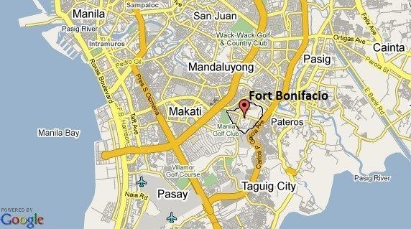
LOCATION

Slide 3
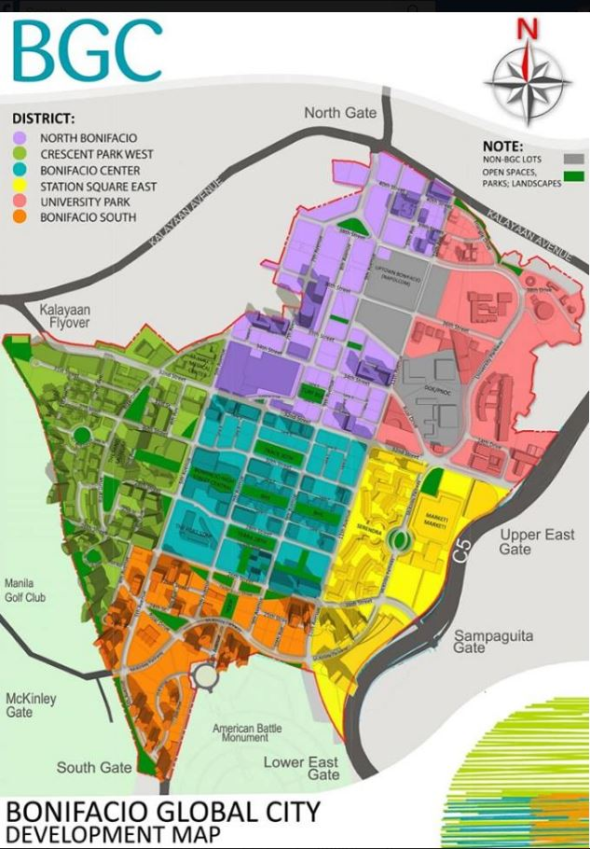
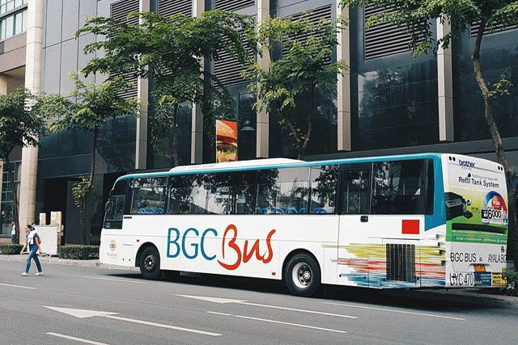
Accessibility

Slide 4
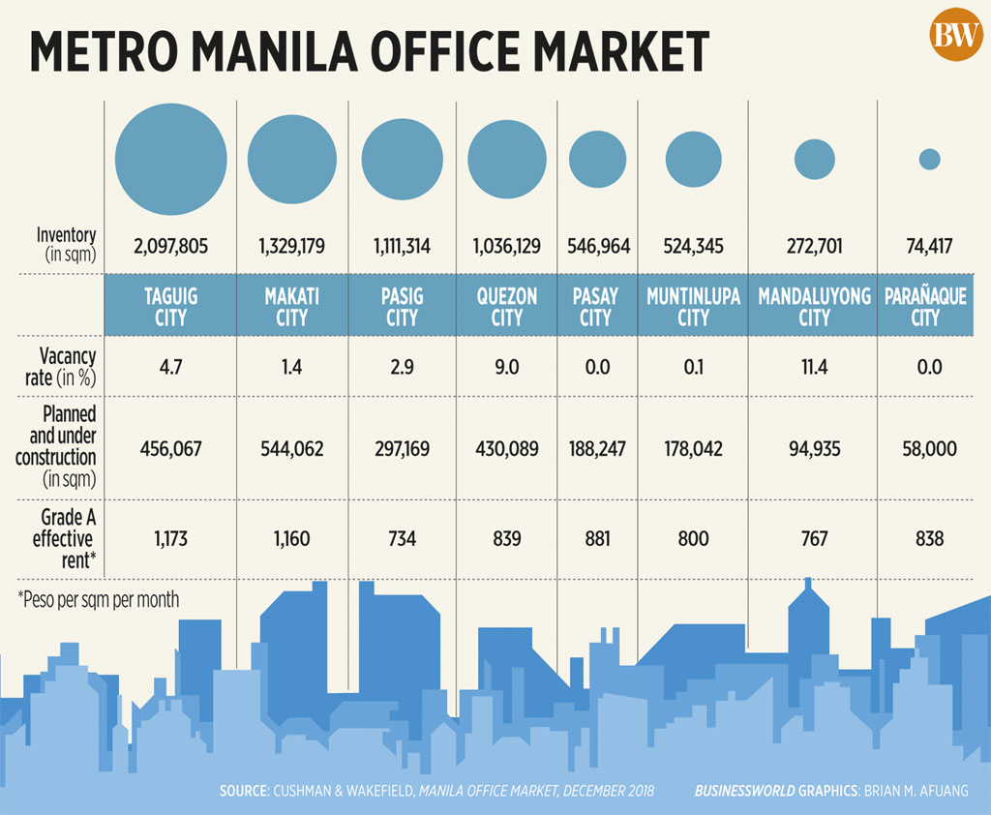
Space Availability

Slide 5
Security
Safe
Clever City Planning
Round the Clock Power

Slide 6
Location
Accessibility
Availability
Security

